Slide 1

Multiplayer Dungeon Quest
BIT IV Semester
Bhavishek lama, […………]
Ravi Kumar Hathi, […………]
Hulas Chandra Chaudhari, […………]
Notes:
Remember to keep your slides simple and easy to read. Use visuals to help illustrate your points, and use bullet points to keep text to a minimum. Make sure your font is large enough to be easily read from the back of the room. And most importantly, practice your presentation so you feel confident and comfortable on the day.
Cover Slide:
This slide should introduce your topic and include the title of your presentation and your name.

Slide 2
Contents / Agenda
Introduction
Problem Statement
Motivation
Features
Objectives
Platform (Development Environment)
Proposed Timeline [Gantt Chart]
Conclusion
Notes:
Content/Agenda:
On this slide, provide a quick overview of what your presentation will cover. This will help your audience understand what to expect.

Slide 3
Introduction
Multiplayer Dungeon Quest is a Java-based 2D dungeon exploration game that offers an immersive and collaborative gameplay experience.
In this game, players explore dark, maze-like dungeons filled with treasures, monsters, and hidden challenges.
The multiplayer component allows multiple players to connect over a network, interact, chat, and cooperate in real-time to navigate the dungeon and defeat powerful enemies.
Notes:
Introduction
Explain why this topic is important to you and to your intended audience.
What we present here
Providing a brief overview of the project idea
Describing the scope and goals of the project
Introducing the project team members and their roles

Slide 4
Problem Statement
Restricted and repetitive gameplay:
Players face static environments with little variation, leading to predictable challenges and a lack of excitement over time. This reduces player engagement and the sense of discovery.
Limited or no interaction:
Many dungeon exploration games lack robust multiplayer systems that encourage real-time communication, cooperation, and shared strategy.
Notes:
Problem Statement
Explain the problem you are trying to solve or the opportunity you are trying to seize. Use data or statistics to support your claims.
What we present here
Identifying the problem that the project aims to solve
Providing background information and context for the problem
Highlighting the importance and impact of the problem on the target audience or stakeholders

Slide 5
Motivation [FONT-SIZE: 36pts]
Enhance Exploration Experience:
The motivation behind Dungeon Quest is to create dynamic, dark environments with hidden treasures and monsters, encouraging players to explore and engage deeply with the game world.
Enhancing Cooperative Gameplay:
There is a growing demand for games that allow players to team up, communicate, and explore challenging environments together.
Notes:
Motivate
Explain why this problem or opportunity is important to you and to your intended audience. Use examples or stories to illustrate your point.
What we present here
Explaining the reason behind selecting this project idea
Discussing the potential benefits and outcomes of the project
Identifying any existing solutions or alternatives and their limitations

Slide 6
Objective
Provide an immersive dungeon exploration experience with dynamic lighting and limited visibility.
Enable real-time multiplayer gameplay
Encourage strategic decision-making, teamwork, and resource management
To implement Object-Oriented Programming, GUI with Swing, JDBC, Sockets, Multithreading.
Notes:
Objectives
Explain your project objectives, including any specific goals you have set for yourself or your team. Be sure to explain how you will measure success.
What we present here
Defining the objectives of the project in terms of outcomes and impact
Providing a clear and measurable definition of success for the project
Outlining the target audience or stakeholders of the project and their needs

Slide 7
Features
Monsters guarding treasures and challenging players in combat.
Player health, inventory, and stats management.
2D dungeon map with fog-of-war effect and dynamic lighting
Real-time multiplayer mode
Notes:
Features
Describe the key features of your proposed solution. Use visuals or diagrams to help illustrate how it works.
What we present here
Describing the key features and functionalities of the project
Discussing any unique or innovative aspects of the project
Outlining the expected deliverables and outcomes of the project

Slide 8
Platform/Dev. Environment
Programming Language:
Java programming
Database:
File Handling
Development Tools:
Visual Studio Code for coding and debugging.
Compiler:
Java Development Kit
Operating System:
Windows
Notes:
Platform / Development Environment
Explain the development environment you will be using to build your solution. Discuss any key tools or technologies you will be using.
What we present here
Identifying the programming language and development tools used for the project
Discussing any relevant technical requirements or constraints
Outlining the testing and debugging strategies for the project

Slide 9
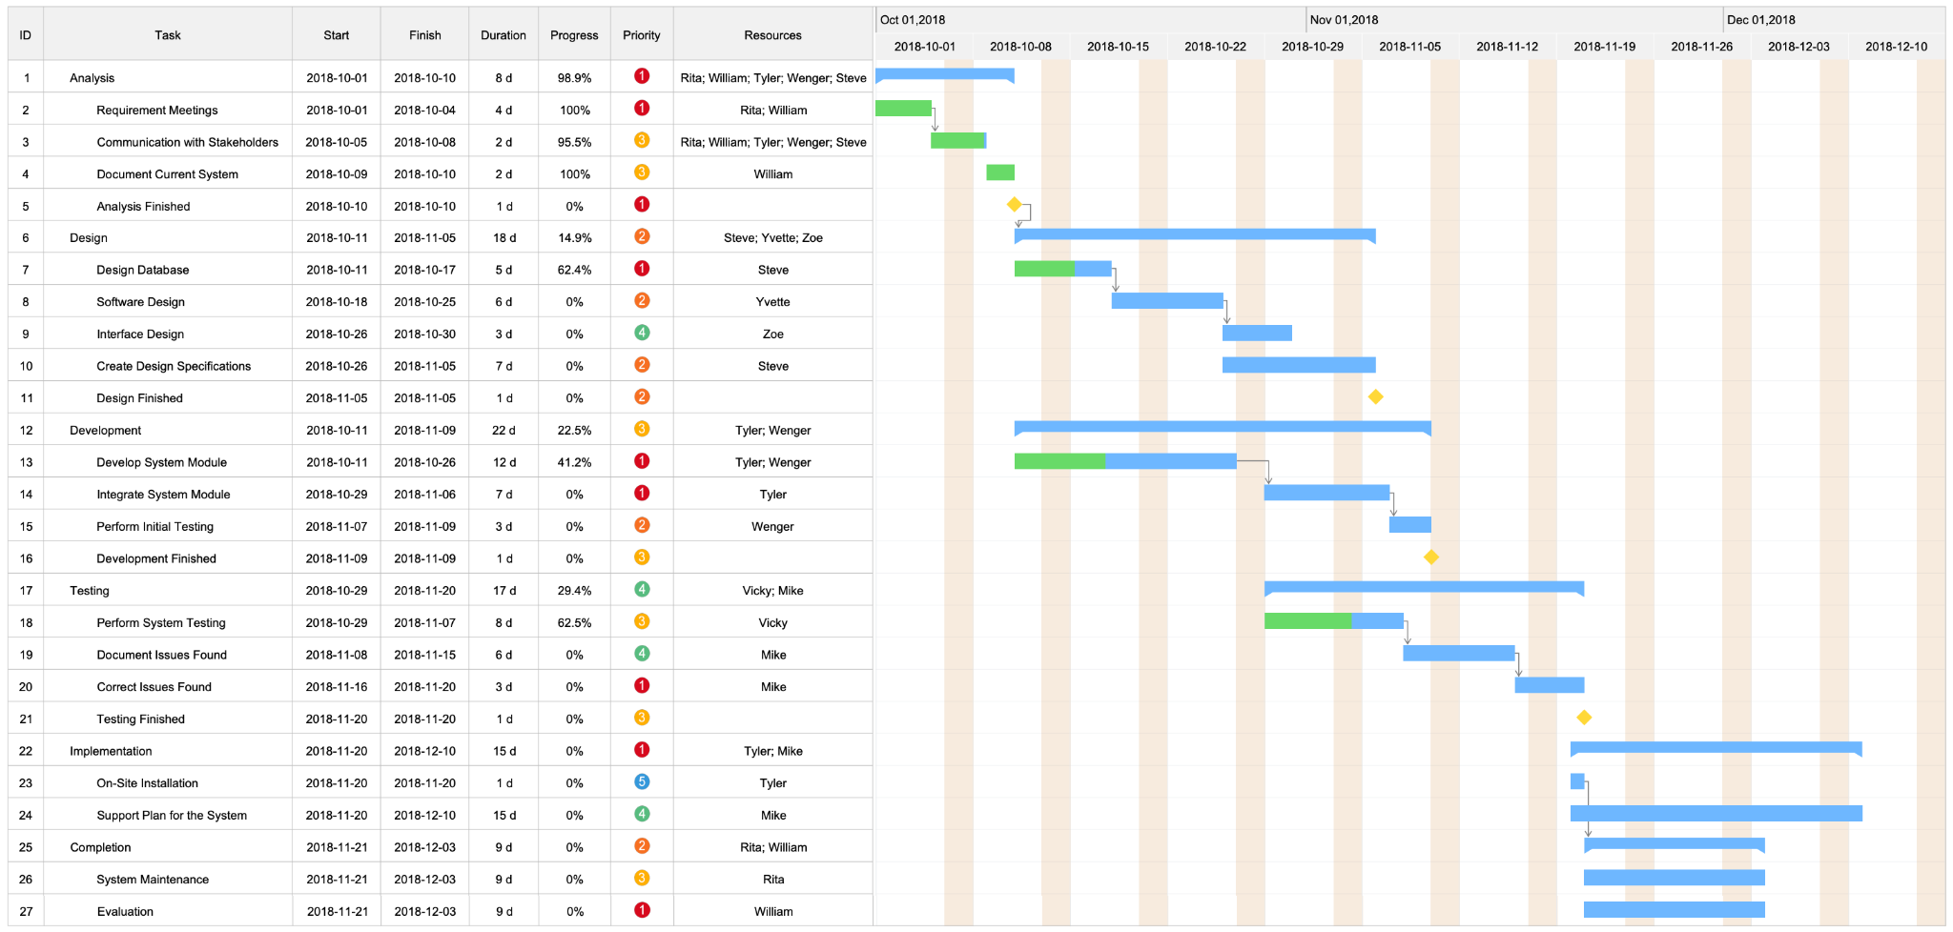
Planned Timeline/Gantt Chart
Notes:
Planned Timeline / Gantt Chart (Roadmap)
Use a Gantt chart or similar tool to illustrate your proposed timeline. Be sure to include key milestones and deadlines.
What we present here
Creating a Gantt chart to show the proposed timeline for the project
Breaking down the project into manageable tasks and milestones
Identifying any critical path or dependencies in the project timeline

Slide 10
Conclusion [FONT-SIZE: 36pts]
To make a thrilling and interactive game
This project demonstrates how Java can be used to build interactive, feature-rich games
Notes:
Conclusion
Summarize your presentation and emphasize why your proposed solution is important. Thank your audience for their time.
What we present here
Summarizing the main points of the project proposal
Reiterating the relevance and significance of the project
Request for feedback and suggestions for improvement.

